Slide 1
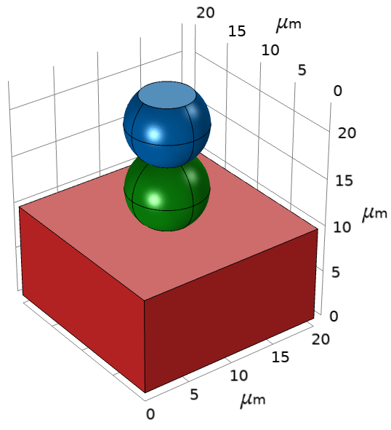
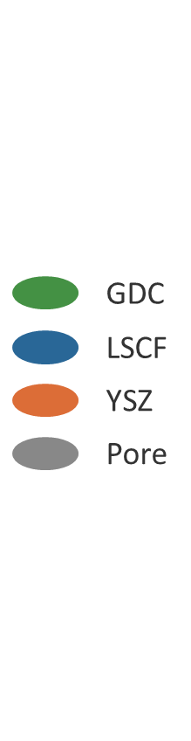
Toy Model Summary

Slide 2
Geometry
YSZ (ion conductor)
10μm
Ni (electron conductor)
Pore
10μm
5μm
5μm
(shape can be pretty arbitrary)

Slide 3
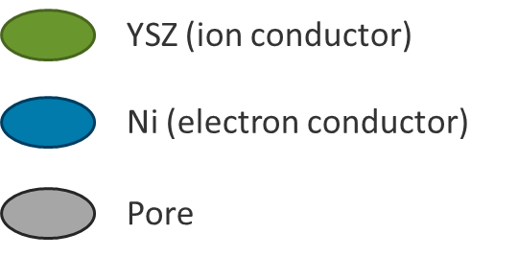
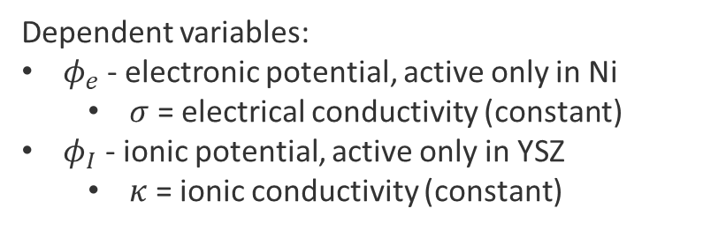


Governing Equations
Dependent variables:
$φ_{e}$ - electronic potential, active only in Ni
$σ$ = electrical conductivity (constant)
$φ_{I}$ - ionic potential, active only in YSZ
$κ$ = ionic conductivity (constant)
$$∇∙\left(σ∇φ_{e}\right)=0$$
$$∇∙\left(κ∇φ_{I}\right)=0$$
(FYI, these are differential forms of Ohm’s law)

Slide 4




Boundary Conditions
$$∇φ_{I}=0$$
$$∇φ_{e}=0$$
$φ_{e}=V_{app}$ (constant)
$$φ_{I}=0$$

Slide 5

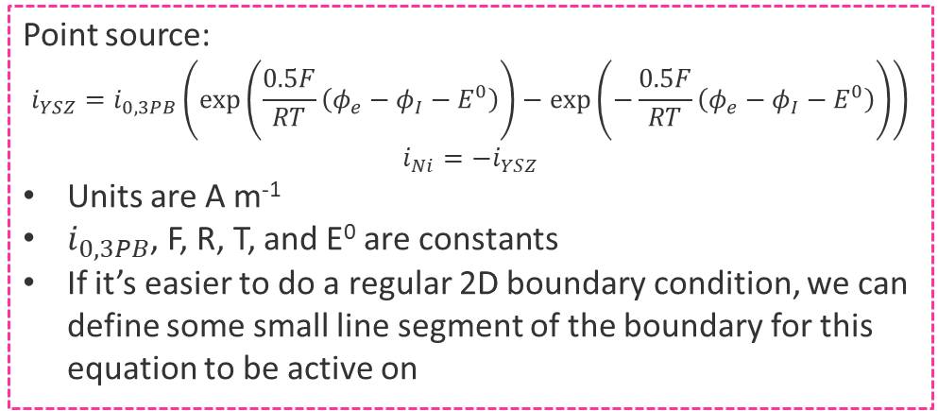

Reactions: Triple Phase Boundary
Point source:
$$i_{YSZ}=i_{0,3PB}\left(\exp\left(\frac{0.5F}{RT}\left(φ_{e}−φ_{I}−E^{0}\right)\right)−\exp\left(−\frac{0.5F}{RT}\left(φ_{e}−φ_{I}−E^{0}\right)\right)\right)$$
$$i_{Ni}=−i_{YSZ}$$
Units are A m⁻¹
$i_{0,3PB}$, F, R, T, and E⁰ are constants
If it’s easier to do a regular 2D boundary condition, we can define some small line segment of the boundary for this equation to be active on

